Slide 1

Vehicle Detection and Monitoring using Magnetic Field Sensors
Pradeep Kumar. N (1BG10EC058)
Nikunj. T (1BG10EC054)
Nafeeya Samar (1BG10EC047)
Noor Zahara (1BG10EC055)
Project Guide:
Anuradha V. Rao

Slide 2



Vehicle Detection and Monitoring using Magnetic Field Sensors
Technical Specifications of Induction Loop detector
Induction Loop
    #12 AWG wire
    6 ft x 6 ft square loop
    Length of lead-in cable = 2m
    Inductance: 100µH
    MC33274 Quad Op-Amp IC used to build oscillator (50KHz) and comparator (V_{cc} = 5V)
    Microcontroller: ATmega2560 Arduino Board
        8-Bit, AVR enhanced RISC architecture
        256KBytes of In-System Self-Programmable Flash
        4Kbytes EEPROM
        8Kbytes Internal SRAM

Slide 3
Vehicle Detection and Monitoring using Magnetic Field Sensors
Circuit Diagram of Colpitt’s Oscillator and comparator
To μC

Slide 4
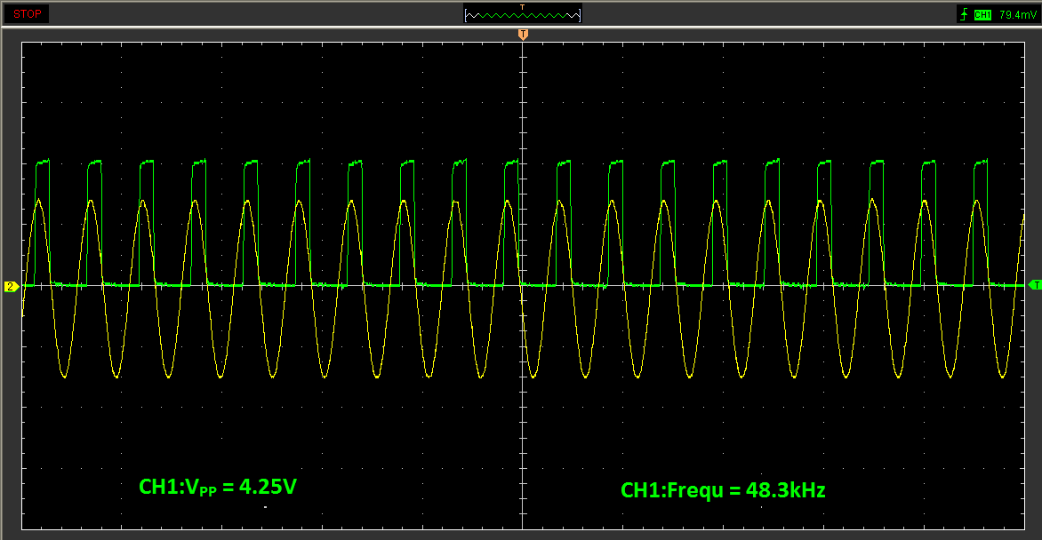
Vehicle Detection and Monitoring using Magnetic Field Sensors
Typical oscillator and comparator output

Slide 5
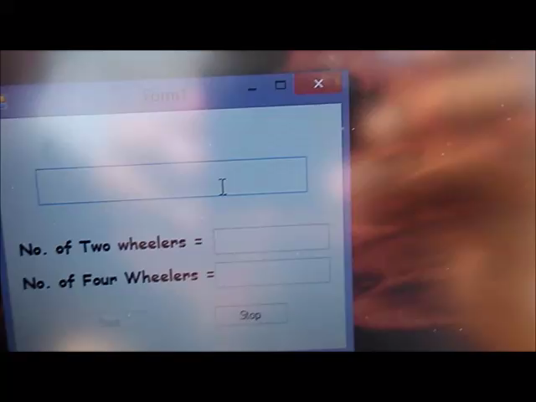
Vehicle Detection and Monitoring using Magnetic Field Sensors
Field test for Induction Loop Detector system

Slide 6
Vehicle Detection and Monitoring using Magnetic Field Sensors
Technical Specifications of AMR sensor Vehicle Detection System
AMR sensor
  Supply voltage: 3 - 5V
  Sensitivity: 16 (mV/V)/(kA/m)
  Total power dissipation: 130mW
    Microcontroller: Jennic JN5148-001
      Low power 32-bit RISC CPU, 4 to 32MHz clock speed
  128kB ROM & 128kB RAM for boot loaded program code & data
  4-input 12-bit ADC, 2 12-bit DACs, 2 comparators
  2 UARTs

Slide 7
Vehicle Detection and Monitoring using Magnetic Field Sensors
Technical Specifications of AMR sensor Vehicle Detection System
Radio Transceiver
  2.4GHz IEEE802.15.4 compliant
  Typical data rate: 256kbps
  500 & 667kbps High data rate modes
  Receiver sensitivity -95dBm
  Transmit power 2.5dBm

Slide 8
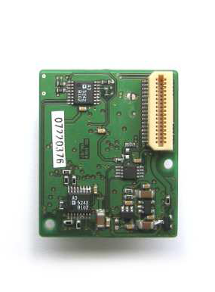
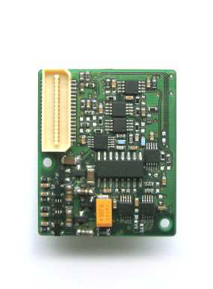
Vehicle Detection and Monitoring using Magnetic Field Sensors
Snapshot of the AMR sensor

Slide 9
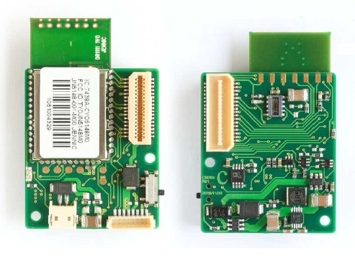
Vehicle Detection and Monitoring using Magnetic Field Sensors
Snapshot of the Wireless microcontroller
(Jennic JN5148)

Slide 10
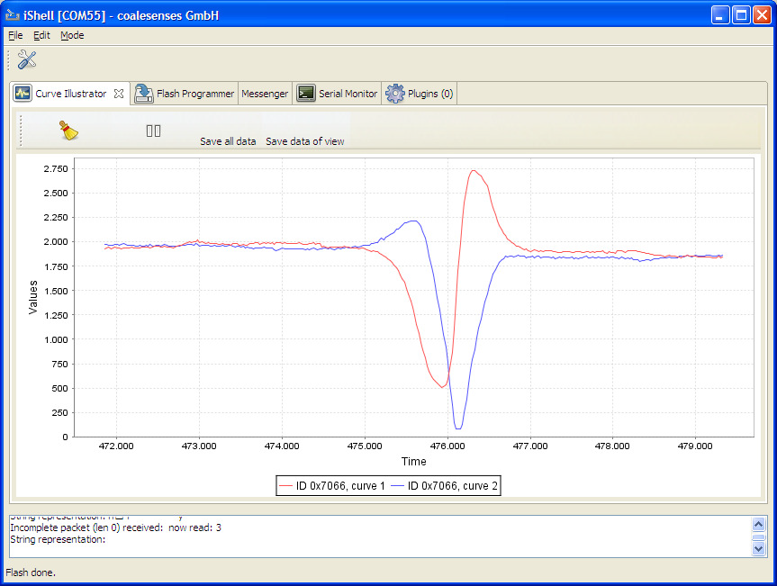
Vehicle Detection and Monitoring using Magnetic Field Sensors
Typical AMR sensor output

Slide 11

Vehicle Detection and Monitoring using Magnetic Field Sensors
Field test for AMR sensor vehicle detection system

Slide 12
Vehicle Detection and Monitoring using Magnetic Field Sensors
Data used to decide the dimension of Induction Loop
Dimensions | No. of turns | Center Frequency | Frequency drift
1.5ft x 1.5ft | 10 | 48.3 kHz | 500 Hz
6ft x 6ft | 2 | 80 kHz (Unstable) | Unreliable
6ft x 6ft | 3 | 51 kHz | 300 Hz
6ft x 6ft | 4 | 41 kHz | 1000 Hz
6ft x 6ft | 5 | 32.5 kHz | 750 Hz
*For four wheelers at 20 kmph

Slide 13
Vehicle Detection and Monitoring using Magnetic Field Sensors
Results for Induction Loop Detector
Type of Vehicle | Speed (kmph) | Frequency drift (Hz) | Avg. frequency drift (Hz)
Two wheeler | 10 | 55 | 55.37
 |  | 52
 |  | 56
 |  | 52
 |  | 64
 |  | 50
 |  | 64
 |  | 50
 | 20 | 50 | 45.42
 |  | 54
 |  | 52
 |  | 42
 |  | 30
 |  | 54
 |  | 36

Slide 14
Vehicle Detection and Monitoring using Magnetic Field Sensors
Results for Induction Loop Detector
Type of Vehicle | Speed (kmph) | Frequency drift (Hz) | Avg. frequency drift (Hz)
Two wheeler | 30 | 48 | 36.25
 |  | 32
 |  | 46
 |  | 24
 |  | 42
 |  | 50
 |  | 22
 |  | 26
 | 40 | 24 | 34.14
 |  | 44
 |  | 36
 |  | 36
 |  | 28
 |  | 26
 |  | 45

Slide 15
Vehicle Detection and Monitoring using Magnetic Field Sensors
Results for Induction Loop Detector
Type of Vehicle | Speed (kmph) | Frequency drift (Hz) | Avg. frequency drift (Hz)
Four wheeler | 10 | 1100 | 1010.8
 |  | 896
 |  | 880
 |  | 962
 |  | 872
 |  | 1106
 |  | 1136
 |  | 990
 |  | 1068
 |  | 1098
 | 20 | 958 | 1006.2
 |  | 1262
 |  | 764
 |  | 806
 |  | 1406
 |  | 900
 |  | 856
 |  | 1010
 |  | 960

Slide 16
Vehicle Detection and Monitoring using Magnetic Field Sensors
Results for Induction Loop Detector
Type of Vehicle | Speed (kmph) | Frequency drift (Hz) | Avg. frequency drift (Hz)
Four wheeler | 30 | 1200 | 1000.2
 |  | 924
 |  | 986
 |  | 1212
 |  | 688
 |  | 952
 |  | 982
 |  | 872
 |  | 940
 |  | 1246
 | 40 | 916 | 937.8
 |  | 746
 |  | 1056
 |  | 1014
 |  | 936
 |  | 960
 |  | 1020
 |  | 899
 |  | 943

Slide 17
Vehicle Detection and Monitoring using Magnetic Field Sensors
Results for AMR sensor vehicle detection system
Type of Vehicle | Actual Speed (kmph) | Detected speed (kmph)
Two Wheelers | 10 | 8.98
 | 10 | 7.64
 | 20 | 18.00
 | 20 | 21.56
 | 30 | 26.54
 | 30 | 28.87
 | 40 | 35.64
 | 40 | 36.11
Four Wheelers | 10 | 10.58
 | 10 | 12.00
 | 20 | 18.23
 | 20 | 20.57
 | 30 | 27.91
 | 30 | 30.35
 | 40 | 37.22
 | 40 | 36.78

Slide 18
Vehicle Detection and Monitoring using Magnetic Field Sensors
Future Enhancements
Induction Loop vehicle detection system
  Two loops can be used to determine the speed of the vehicles.
    AMR vehicle detection system
      Sensors with higher sampling rate can be used to classify vehicles based on their magnetic signature.
      Auxiliary sensors such as video processing systems and infrared sensors can be used in conjunction with the induction loop and AMR sensor systems to eliminate false counts and increase the accuracy of the traffic parameters acquired.

Slide 19
Vehicle Detection and Monitoring using Magnetic Field Sensors
Conclusions
Advantages of Induction loop detector system: initial installation costs are much lower; can also detect stopped vehicles.
However, AMR sensors are more sensitive to the presence of magnetic materials.
They are easy to reinstall and maintenance costs are low.
Smaller in size compared to inductive loops which require a minimum area of around 36 sq. ft.
They are more energy efficient, use state-of-the-art low-power sensing, amplification, and communication technologies.
Thus magnetic sensor systems are more efficient and reliable than induction loops.

